Slide 1


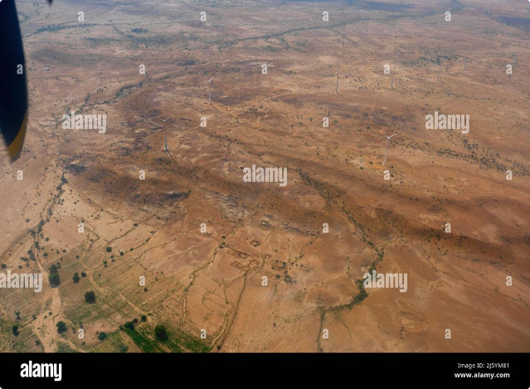


Thar Desert Analysis
Welcome to this comprehensive analysis of the Thar Desert. This presentation explores various aspects of the Thar Desert, including its geography, climate, and human impact.
by Gayathri Harika

Slide 2
Overview of the Thar Desert
Geography
Climate
Biodiversity
The Thar Desert, also known as the Great Indian Desert, stretches across northwest India and southeast Pakistan. It is the world's 17th largest desert, spanning over 200,000 square kilometers.
The Thar Desert experiences extreme temperatures, with hot summers and cold winters. The desert receives minimal rainfall, making it a harsh environment for life.
Despite its aridity, the Thar Desert is home to a surprising diversity of flora and fauna. This includes desert plants adapted to conserve water, as well as mammals like the desert fox and the Indian wolf.

Slide 3

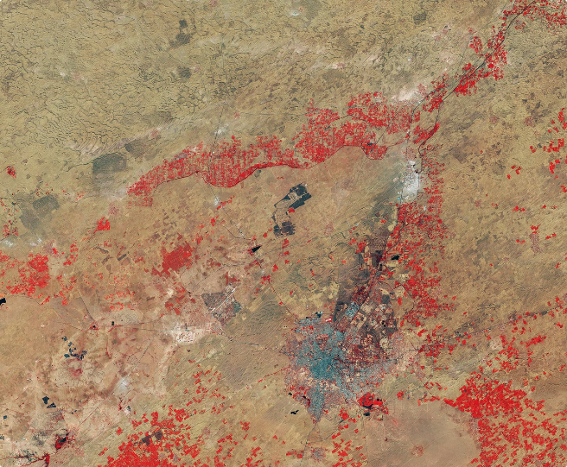
Data Collection Methodology
1
Satellite Data
Utilizing satellite imagery to monitor land use changes, vegetation cover, and water resources within the Thar Desert.
2
Ground Truth Validation
Conducting fieldwork and surveys to validate satellite data and gather local insights on ecological conditions.
3
Historical Records
Collecting and analyzing historical weather data, population trends, and economic activities to understand long-term patterns.

Slide 4
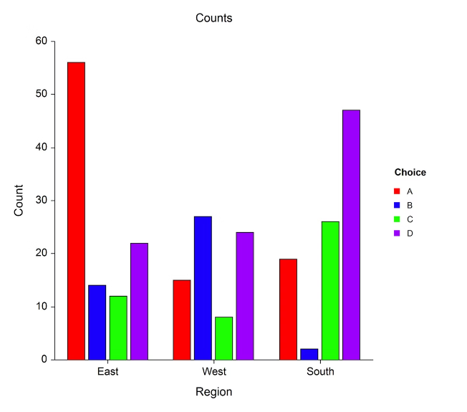
Data Cleaning and Preprocessing
1
Data Consistency
Ensuring uniformity in data formats, units, and time periods, handling missing data points, and identifying outliers.
2
Spatial Processing
Geo-referencing data to accurately represent spatial locations, aligning data with geographic boundaries, and creating spatial layers.
3
Feature Engineering
Creating new variables or transforming existing ones to improve model performance and gain meaningful insights.

Slide 5
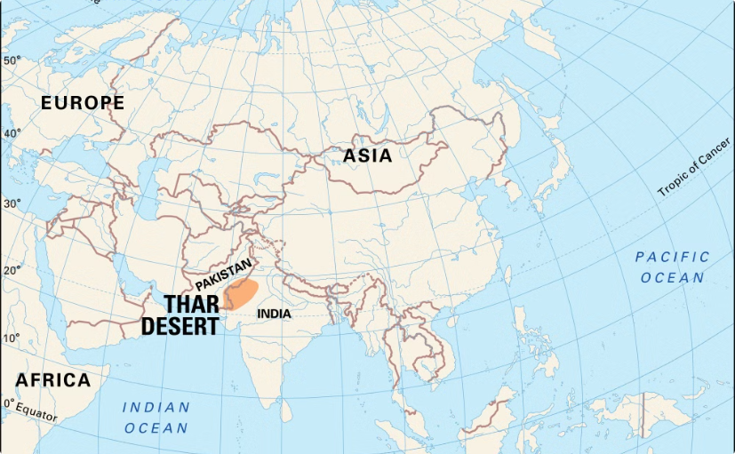
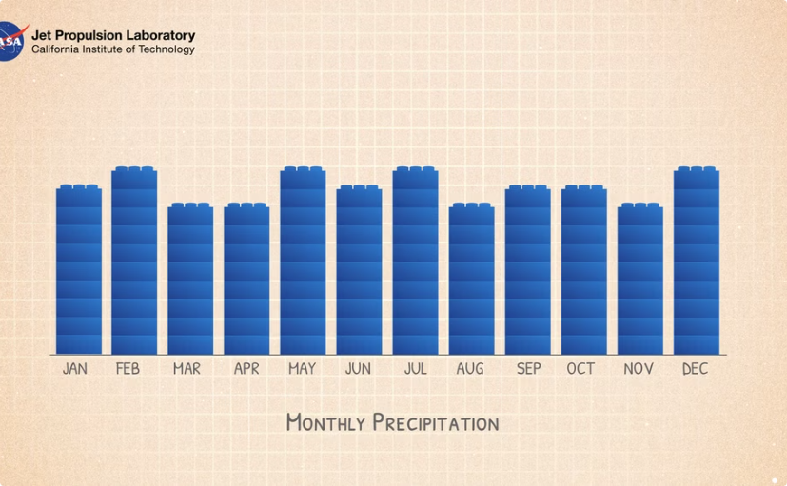
Exploratory Data Analysis
Spatial Distribution
Temporal Trends
Visualizing the distribution of environmental indicators across the Thar Desert, revealing patterns of resource availability and human settlements.
Examining trends in rainfall, temperature, and other environmental factors over time to understand their impact on the desert ecosystem.

Slide 6


Identifying Key Insights
Population Growth
Impact on water resources and land use
Climate Change
Increased aridity and drought frequency
Resource Management
Sustainability of water, land, and biodiversity

Slide 7


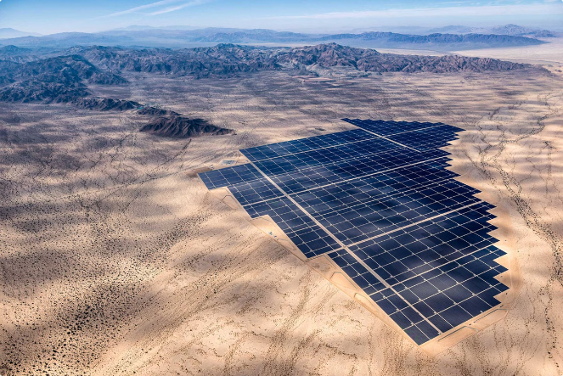



Recommendations for Business Decisions
Promote Sustainable Agriculture
Encouraging water-efficient farming techniques, drought-resistant crops, and sustainable land management practices.
Develop Renewable Energy Sources
Leveraging the desert's abundant solar energy potential to reduce reliance on fossil fuels.
Invest in Water Conservation
Implementing rainwater harvesting, groundwater recharge, and efficient irrigation systems to mitigate water scarcity.
Support Community-Based Conservation
Empowering local communities to actively participate in conservation efforts, promoting sustainable livelihoods, and preserving biodiversity.

Slide 8

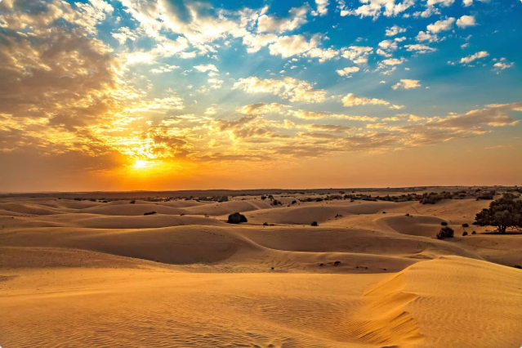
Conclusion
The analysis highlights the importance of understanding the complexities of the Thar Desert ecosystem. By applying data-driven insights, we can formulate strategies for sustainable development and conservation, ensuring the well-being of the desert and its inhabitants.

